Slide 1

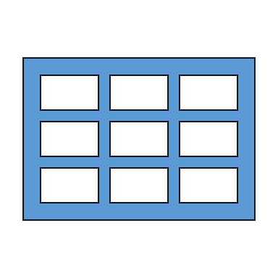

Module: Table & Table extensions

Slide 2

Topics to be covered:
Use of visual studio snippets to create a new table
important table properties
fields and field properties
Field and table level triggers
Diving into table extensions

Slide 3

Table and table extension based Visual Studio Code Snippets
Associated visual studio table and table extension related snippet
ttable
tfield
tkey

Slide 4
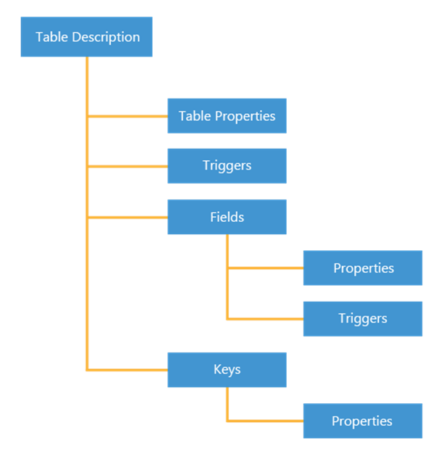
A table consists of two parts: the table data and a table description
Roll 1 | John | Grade I | Sec B
Roll 2 | Mohan | Grade II | Sec A
Roll 3 | Elina | Grade I | Sec A
Roll 4 | Patricia | Grade IV | Sec A
Roll 5 | Heena | Grade II | Sec C

Slide 5
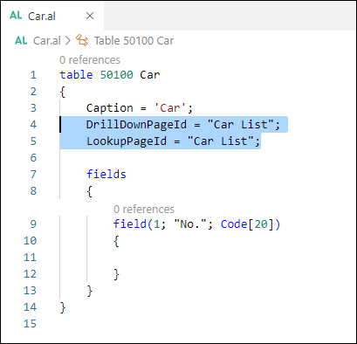
Table properties
ID and name properties
Caption property
DataCaptionFields property
DataPerCompany property
DataClassification property
LookupPageId and DrillDownPageId properties

Slide 6
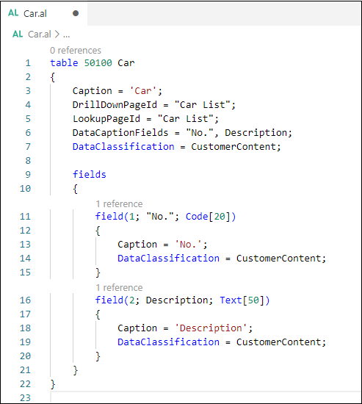
Field and their properties
Field No. and Name properties Reflecting the data type it can hold
Text
Code
Decimal
Integer
BigInteger
Binary
Option
Enum
Boolean
Date
Time
DateFormula
DateTime
Duration
BLOB
Media
MediaSet
RecordID
TableFilter
GUID

Slide 7
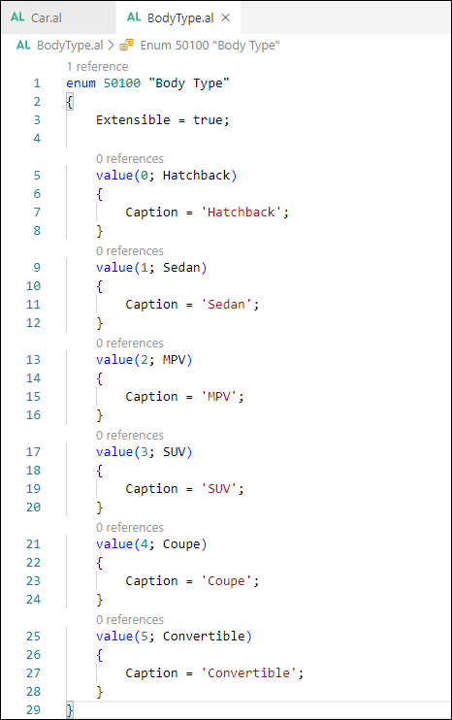
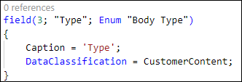
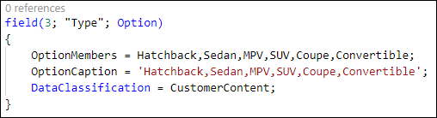
Field and their properties continuation

Slide 8
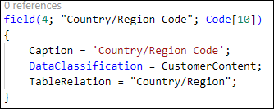
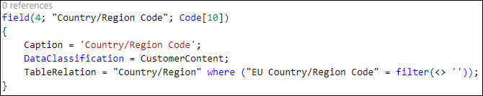
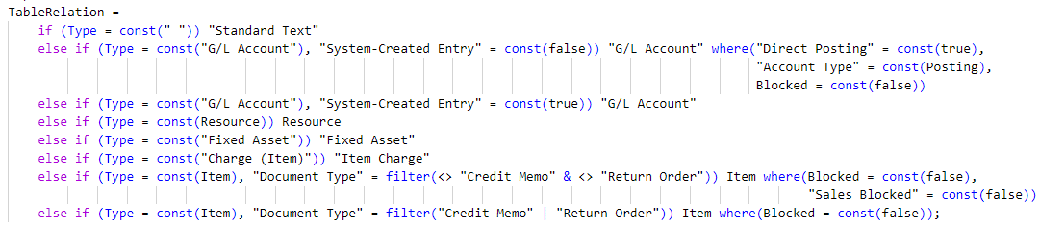
Linking Different Tables With Table Relations
Filtered Variant
Regular Variant
Conditional Variant
Notes:
TableRelation is a table property that is used to establish a relation between two tables, such as between the Customer table and the Countries table. For example, a customer is located in a certain country; therefore, a relation exists between the Customer and Country tables.
The TableRelation property lets you establish lookups into other tables. This property will show a drop-down menu on pages, where a user can select a value from the linked table.
Regular table relation
A regular table relation is a simple relationship between two tables. In this type of relationship, you can specify the table that you want to link with in the TableRelation property. If you specify the table, you will automatically link to the primary key of that table.
Filtered table relation
A regular table relation shows all the records from the linked table. With a filtered table relation, you can limit the records that are displayed by using one or more filters on the table records. As a result, a filtered table relation only shows a subset of the records.
In the following example, the Country/Region code is filtered to show only countries where the EU Country/Region Code field is not blank.
Conditional table relation
A conditional table relation is a dynamic table relationship because it's not fixed to one table. The link depends on a condition; therefore, depending on the evaluation of a condition, you might relate to one or another table.
A conditional table relation is used in the sales lines of a sales order. Depending on the Type field, the No. field will link to other tables.

Slide 9
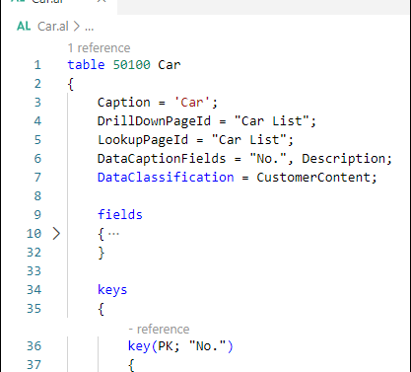
Create Primary and Secondary Keys on a Table
The primary key is always the first in the list
A primary key can also consist of more than one field
Secondary keys are optional, and they can help you perform search actions faster

Slide 10
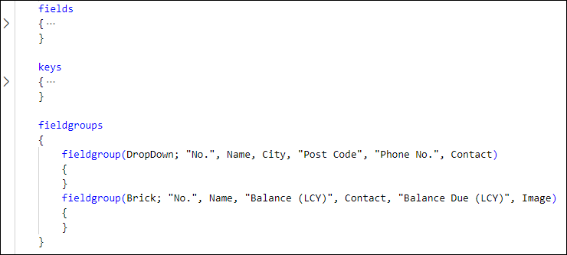
Work with Dropdown and Brick Field Groups
The DropDown fieldgroup is used to define the fields that will be displayed on a dropdown list.
A Brick fieldgroup is used to display a list in tiles. You can see an example of this in the Customer List.

Slide 11
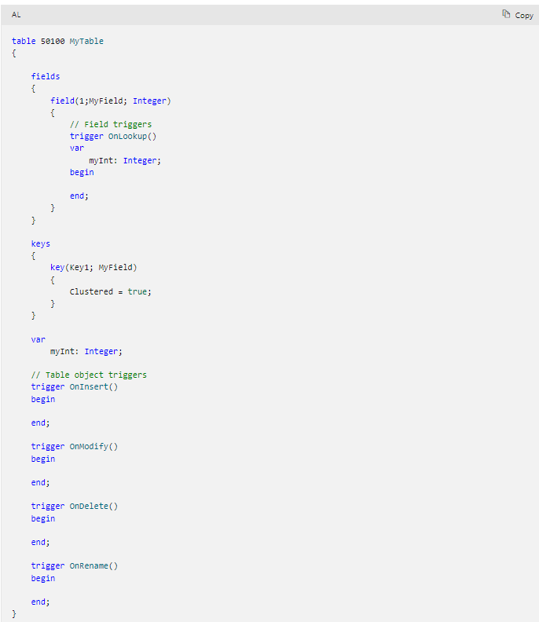
Table triggers
Snippet support
Typing the shortcut ttrigger will create the basic layout for a trigger when using the AL Language extension for Microsoft Dynamics 365 Business Central in Visual Studio Code.

Slide 12
Table Triggers

Slide 13
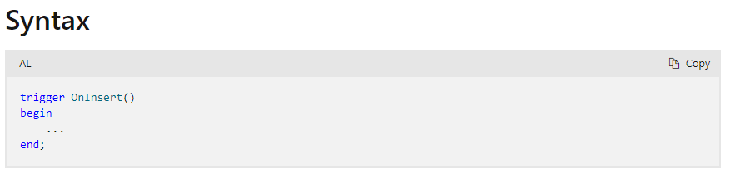
The OnInsert() trigger
Run before default insert behaviour
Validates the record to be inserted doesn’t already exist before insertion

Slide 14
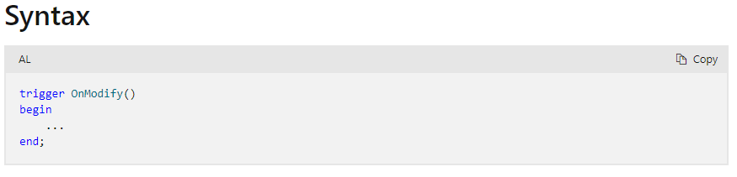
The OnModify() trigger
Run before default modify behaviour
Validates all fields of record prior to modification

Slide 15
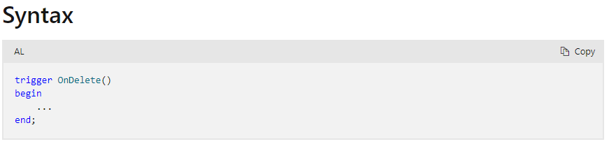
The OnDelete() trigger
Run before default delete behaviour
Validates if record exists before the deletion occurs

Slide 16
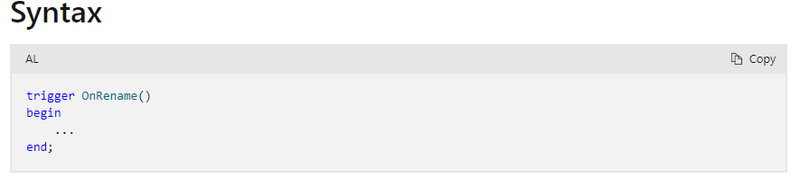
The OnRename() trigger
Run when the user changes a record’s primary key field in a page from web client
Runs after field validation and before default renaming operation

Slide 17
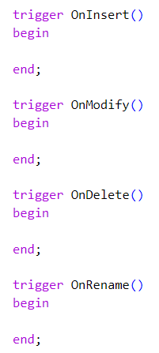
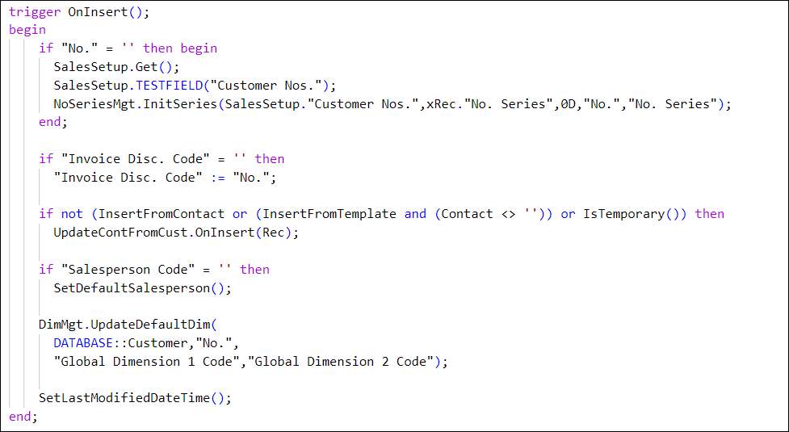
Table Triggers

Slide 18
The FieldClass property can be one of three values:
Normal
FlowField
FlowFilter
Types of calculation formulas for a field of type FlowField:
Sum - The sum of a specified set in a column in a table
Lookup - Looks up a value in a column in another table
Count - The number of records in a specified set in a table
Exist - Indicates whether any records exist in a specified set in a table
Average - The average value of a specified set in a column in a table
Min - The minimum value in a column in a specified set in a table
Max - The maximum value in a column in a specified set in a table
Create And Use Calculated Fields
Notes:
Calculated fields are fields where the value is calculated instead of stored in the database. Calculated fields can be implemented by using a special field property, the FieldClass property. Because it's a field property, you must define the FieldClass property for each field in the table.
The FieldClass property can be one of three values:
Normal
FlowField
FlowFilter
By default, every field that you create has a FieldClass value of Normal. A Normal field contains data that is stored in the database. Most fields in the Business Central database are normal fields.
With FlowFields, your data isn't stored in a table, but it is calculated. When you need to calculate something, a calculation formula is used. When you create a field of type FlowField, you must also provide a formula in the CalcFormula property. The calculation formula is stored in the database.
You can have different types of calculation formulas:
Sum - The sum of a specified set in a column in a table (data type: decimal)
Lookup - Looks up a value in a column in another table (data type: any)
Count - The number of records in a specified set in a table (data type: integer)
Exist - Indicates whether any records exist in a specified set in a table (data type: Boolean)
Average - The average value of a specified set in a column in a table (data type: decimal)
Min - The minimum value in a column in a specified set in a table (data type: any)
Max - The maximum value in a column in a specified set in a table (data type: any)
The third property value is FlowFilter, which is designed to be used in the calculation formula of a FlowField. It holds a temporary value, which is used for filtering in the calculation formula. Instead of a developer predefining a fixed filter, a FlowFilter allows the end user to provide a value that is then used in the calculation.

Slide 19
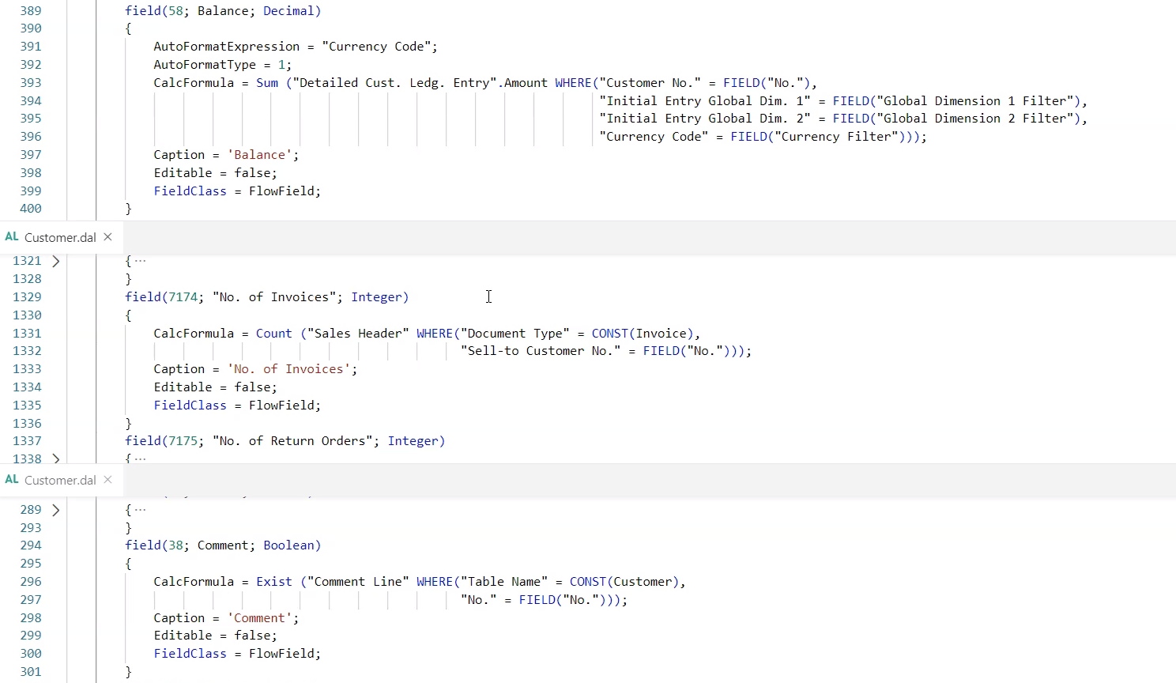
Example

Slide 20
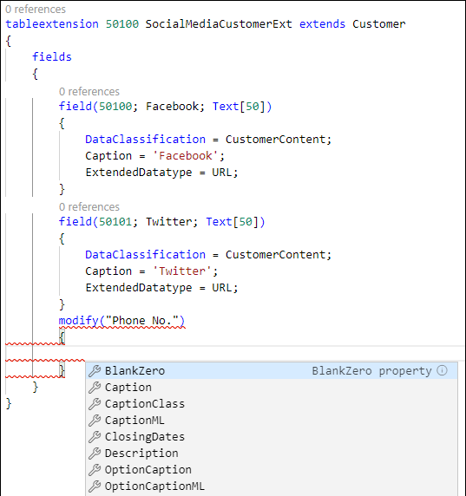
Creating Table Extensions
The TableExtension object is used to extend existing tables.
Important to know about TableExtension objects.
You can't change the ID and the Name properties.
You can't delete existing fields.
You can’t change the length of a field.
You can’t modify or remove existing keys.
Create a table extension by using the ttableext snippet, and add fields to the table by using the tfield snippet.
Notes:
If you want to add extra fields to an existing table, or only want to modify some properties, you need to use table extensions.
The TableExtension object is used to extend existing tables in the Business Central application. The following key points are important to know about TableExtension objects.
With a table extension, you can modify some table properties but not all of them. For example, you can't change the ID and the Name properties.
You can add new fields and modify some properties of existing fields, but you can't delete existing fields. If you have a field of type Text or Code, and want to change the length of that field, you can't because that's not possible.
You can create new secondary keys but not modify or remove existing keys.
Creating a table extension works the same way as creating a table, by using the ttableext snippet. Additionally, you can add fields like you would add fields to a normal table by using the tfield snippet.
Every table extension has its own name. As previously discussed in the Work with tables in Dynamics 365 Business Central module, we recommend that you use a prefix or suffix in the name of your object so that it's unique. For each field in the table extension, you need to specify a prefix or suffix in the name of the field.
To modify an existing field in a table, you can use the modify keyword. No snippet exists for modifying a field in a table.

Slide 21

Table Properties That can be Changed in Extension
You can only change the following table properties by using a table extension:
Caption
DataCaptionFields
Description
DrillDownPageId
LookupPageId
You can only change the following field properties:
BlankZero
Caption
CaptionClass
Description
OptionCaption (only for data type option)
TableRelation
Width

